Slide 1
8.3 뉴럴 스타일 트랜스퍼

Slide 2
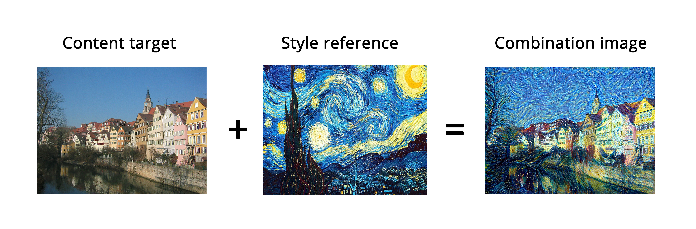
01
PPT PRESENTATION Enjoy your stylish business and campus life with BIZCAM
Loss = distance(style(reference_image) – style(generated_image)) +
distance(content(original_image) – content(generated_image))

Slide 3
8.3.1 콘텐츠 손실

Slide 4
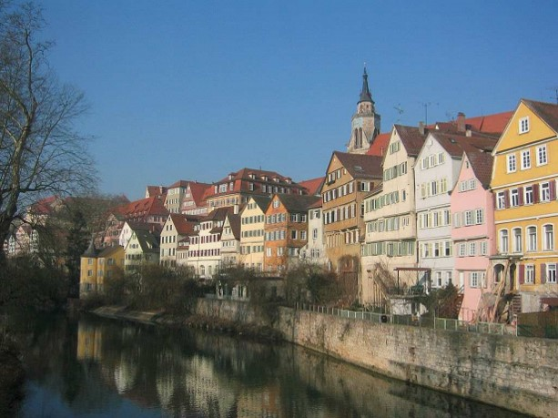
01
PPT PRESENTATION Enjoy your stylish business and campus life with BIZCAM
Feature map F
Feature map P
CNN
CNN
img
Content img

Slide 5
8.3.2 스타일 손실

Slide 6
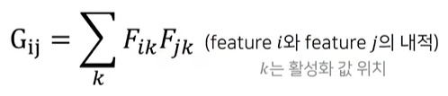
01
PPT PRESENTATION Enjoy your stylish business and campus life with BIZCAM
Gram Matrix
G11 | G12 | G13
G21 | G22 | G23
G31 | G32 | G33
feature 3
feature 2
특정 layer
feature 1

Slide 7
8.3.3 케라스에서 뉴럴 스타일 트랜스퍼 구현

Slide 8
01
PPT PRESENTATION Enjoy your stylish business and campus life with BIZCAM
코드8-14 변수 초기값 정의하기
from keras.preprocessing.image import load_img, img_to_array, save_img
target_image_path = './datasets/portrait.png'
style_reference_image_path = './datasets/popova.jpg'
width, height = load_img(target_image_path).size
img_height = 400
img_width = int(width * img_height / height)

Slide 9
01
PPT PRESENTATION Enjoy your stylish business and campus life with BIZCAM
코드8-15 유틸리티 함수
import numpy as np
from keras.applications import vgg19
def preprocess_image(image_path):
img = load_img(image_path, target_size=(img_height, img_width))
img = img_to_array(img)
img = np.expand_dims(img, axis=0)
img = vgg19.preprocess_input(img)
return img
def deprocess_image(x):
# ImageNet의 평균 픽셀 값을 더합니다
x[:, :, 0] += 103.939
x[:, :, 1] += 116.779
x[:, :, 2] += 123.68
# 'BGR'->'RGB'
x = x[:, :, ::-1]
x = np.clip(x, 0, 255).astype('uint8')
return x

Slide 10
01
PPT PRESENTATION Enjoy your stylish business and campus life with BIZCAM
코드8-16 사전 훈련된 VGG19 네트워크를 로딩하고 3개 이미지에 적용
from keras import backend as K
target_image = K.constant(preprocess_image(target_image_path))
style_reference_image = K.constant(preprocess_image(style_reference_image_path))
# 생성된 이미지를 담을 플레이스홀더
combination_image = K.placeholder((1, img_height, img_width, 3))
# 세 개의 이미지를 하나의 배치로 합칩니다
input_tensor = K.concatenate([target_image,
style_reference_image,
combination_image], axis=0)
# 세 이미지의 배치를 입력으로 받는 VGG 네트워크를 만듭니다.
# 이 모델은 사전 훈련된 ImageNet 가중치를 로드합니다
model = vgg19.VGG19(input_tensor=input_tensor,
weights='imagenet',
include_top=False)
print('모델 로드 완료.')

Slide 11
01
PPT PRESENTATION Enjoy your stylish business and campus life with BIZCAM
코드8-17 손실과 그람행렬
def content_loss(base, combination):
return K.sum(K.square(combination - base))
def gram_matrix(x):
features = K.batch_flatten(K.permute_dimensions(x, (2, 0, 1)))
gram = K.dot(features, K.transpose(features))
return gram
def style_loss(style, combination):
S = gram_matrix(style)
C = gram_matrix(combination)
channels = 3
size = img_height * img_width
return K.sum(K.square(S - C)) / (4. * (channels ** 2) * (size ** 2))

Slide 12
01
PPT PRESENTATION Enjoy your stylish business and campus life with BIZCAM
코드8-19 총 변위 손실
def total_variation_loss(x):
a = K.square(
x[:, :img_height - 1, :img_width - 1, :] - x[:, 1:, :img_width - 1, :])
b = K.square(
x[:, :img_height - 1, :img_width - 1, :] - x[:, :img_height - 1, 1:, :])
return K.sum(K.pow(a + b, 1.25))

Slide 13
01
PPT PRESENTATION Enjoy your stylish business and campus life with BIZCAM
코드8-20 최소화할 최종 손실 정의
outputs_dict = dict([(layer.name, layer.output) for layer in model.layers])
content_layer = 'block5_conv2'
style_layers = ['block1_conv1','block2_conv1','block3_conv1','block4_conv1’,
'block5_conv1']
total_variation_weight = 1e-4
style_weight = 1.
content_weight = 0.025
loss = K.variable(0.)
layer_features = outputs_dict[content_layer]
target_image_features = layer_features[0, :, :, :]
combination_features = layer_features[2, :, :, :]
loss += content_weight * content_loss(target_image_features,combination_features)
for layer_name in style_layers:
layer_features = outputs_dict[layer_name]
style_reference_features = layer_features[1, :, :, :]
combination_features = layer_features[2, :, :, :]
sl = style_loss(style_reference_features, combination_features)
loss += (style_weight / len(style_layers)) * sl
loss += total_variation_weight * total_variation_loss(combination_image)

Slide 14
01
PPT PRESENTATION Enjoy your stylish business and campus life with BIZCAM
코드8-21 경사 하강법 단계 설정하기
grads = K.gradients(loss, combination_image)[0]
# 현재 손실과 그래디언트의 값을 추출하는 케라스 Function 객체입니다
fetch_loss_and_grads = K.function([combination_image], [loss, grads])
class Evaluator(object):
def __init__(self):
self.loss_value = None
self.grads_values = None
def loss(self, x):
assert self.loss_value is None
x = x.reshape((1, img_height, img_width, 3))
outs = fetch_loss_and_grads([x])
loss_value = outs[0]
grad_values = outs[1].flatten().astype('float64')
self.loss_value = loss_value
self.grad_values = grad_values
return self.loss_value
def grads(self, x):
assert self.loss_value is not None
grad_values = np.copy(self.grad_values)
self.loss_value = None
self.grad_values = None
return grad_values
evaluator = Evaluator()

Slide 15
01
PPT PRESENTATION Enjoy your stylish business and campus life with BIZCAM
코드8-22 스타일 트랜스퍼 반복 루프
from scipy.optimize import fmin_l_bfgs_b
import time
result_prefix = 'style_transfer_result'
iterations = 20
# 뉴럴 스타일 트랜스퍼의 손실을 최소화하기 위해 생성된 이미지에 대해 L-BFGS 최적화를 수행합니다
# 초기 값은 타깃 이미지입니다
# scipy.optimize.fmin_l_bfgs_b 함수가 벡터만 처리할 수 있기 때문에 이미지를 펼칩니다.
x = preprocess_image(target_image_path)
x = x.flatten()
for i in range(iterations):
print('반복 횟수:', i)
start_time = time.time()
x, min_val, info = fmin_l_bfgs_b(evaluator.loss, x,
fprime=evaluator.grads, maxfun=20)
print('현재 손실 값:', min_val)
# 생성된 현재 이미지를 저장합니다
img = x.copy().reshape((img_height, img_width, 3))
img = deprocess_image(img)
fname = result_prefix + '_at_iteration_%d.png' % i
save_img(fname, img)
end_time = time.time()
print('저장 이미지: ', fname)
print('%d 번째 반복 완료: %ds' % (i, end_time - start_time))

Slide 16
8.3.4 정리

Slide 17
01
PPT PRESENTATION Enjoy your stylish business and campus life with BIZCAM
••••••
•스타일 트랜스퍼란?
•콘텐츠는 컨브넷 상위 층의 활성화에서 얻을 수 있다.
•스타일은 여러 컨브넷 층의 활성화 안에 내재된 상관관계에서 얻을 수 있다.
•이런 기본 아이디어에서 출발하여 다양한 변종과 개선 가능

Slide 18
8.4 변이형 오토인코더를 사용한 이미지 생성

Slide 19
8.4.1 이미지의 잠재 공간에서 샘플링하기

Slide 20
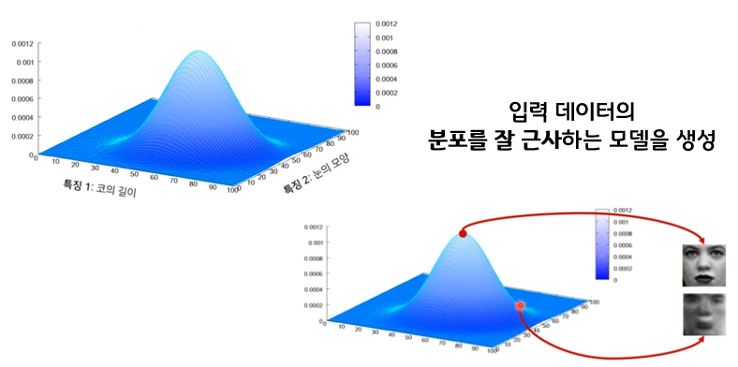

01
PPT PRESENTATION Enjoy your stylish business and campus life with BIZCAM
훈련 데이터
생성자 / 디코더
이미지 잠재 공간
벡터
합성 이미지

Slide 21
8.4.2 이미지 변형을 위한 개념벡터

Slide 22

01
PPT PRESENTATION Enjoy your stylish business and campus life with BIZCAM
z
s
z

Slide 23
8.4.3 변이형 오토인코더

Slide 24
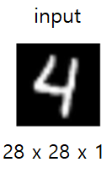
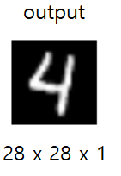
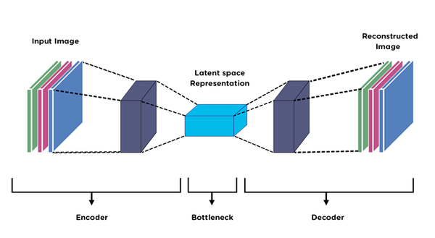
01
PPT PRESENTATION Enjoy your stylish business and campus life with BIZCAM
Autoencoder

Slide 25
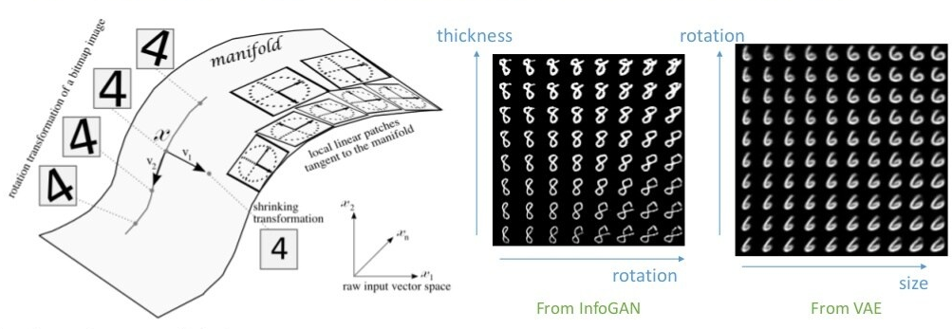
01
PPT PRESENTATION Enjoy your stylish business and campus life with BIZCAM

Slide 26
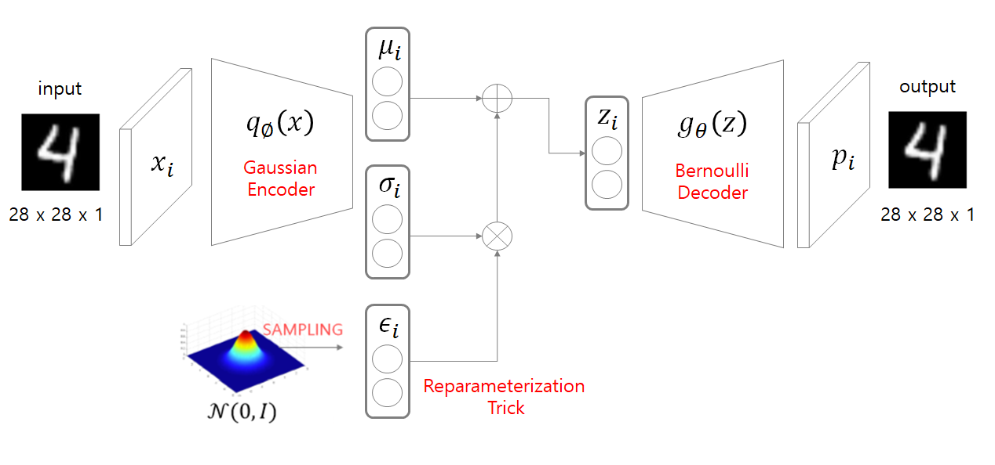
01
PPT PRESENTATION Enjoy your stylish business and campus life with BIZCAM

Slide 27
01
PPT PRESENTATION Enjoy your stylish business and campus life with BIZCAM
VAE
z_mean , z_log_var = encoder(input_img)
z = z_mean + exp(0.5 * z_log_var) * epsilon
reconstructed_img = decoder(z)
model = Model(input_img,reconstructed_img))

Slide 28
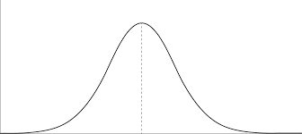
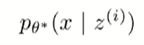
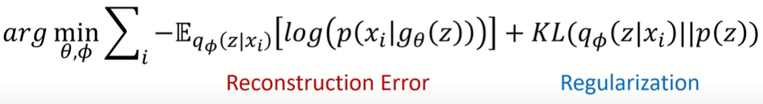
01
PPT PRESENTATION Enjoy your stylish business and campus life with BIZCAM
Reconstruction
loss
◀
원본 입력과 동일하도록
▶
Regularization loss
◀
동일한 분포를 가지도록
▶

Slide 29
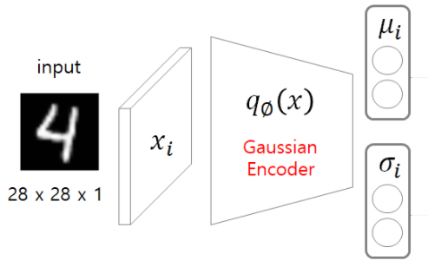
01
PPT PRESENTATION Enjoy your stylish business and campus life with BIZCAM
인코더
8-23 VAE 인코더 네트워크
img_shape = (28,28,1)
batch_size = 16
latent_dim = 2
input_img = keras.Input(shape = img_shape)
x = layers.Conv2D(32,3,padding='same',activation='relu')(input_img)
x = layers.Conv2D(64,3,padding='same',activation='relu',strides=(2,2))(x)
x = layers.Conv2D(64,3,padding='same',activation='relu')(x)
x = layers.Conv2D(64,3,padding='same',activation='relu')(x)
shape_before_flattening = K.int_shape(x) # return tuple of integers of shape of x
x = layers.Flatten()(x)
x = layers.Dense(32,activation='relu')(x)
z_mean = layers.Dense(latent_dim)(x)
z_log_var = layers.Dense(latent_dim)(x)

Slide 30
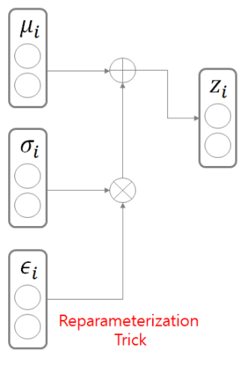
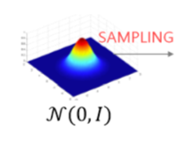
01
PPT PRESENTATION Enjoy your stylish business and campus life with BIZCAM
샘플링
8-24 잠재 공간 샘플링 함수
def sampling(args):
z_mean, z_log_var = args
epsilon = K.random_normal(shape=(K.shape(z_mean)[0],latent_dim),mean=0., stddev=1.)
return z_mean + K.exp(z_log_var) * epsilon
z = layers.Lambda(sampling)([z_mean, z_log_var])

Slide 31
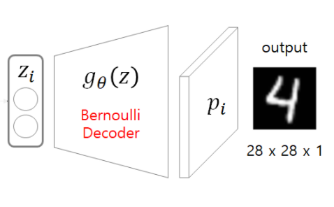
01
PPT PRESENTATION Enjoy your stylish business and campus life with BIZCAM
디코더
8-25 잠재 공간 포인트를 이미지로 매핑하는 VAE 디코더 네트워크
decoder_input = layers.Input(K.int_shape(z)[1:])
x = layers.Dense(np.prod(shape_before_flattening[1:]),activation='relu')(decoder_input)
x = layers.Reshape(shape_before_flattening[1:])(x)
x = layers.Conv2DTranspose(32,3,padding='same',activation='relu',strides=(2,2))(x)
x = layers.Conv2D(1,3,padding='same',activation='sigmoid')(x)
decoder = Model(decoder_input, x)
z_decoded = decoder(z)

Slide 32
01
PPT PRESENTATION Enjoy your stylish business and campus life with BIZCAM
Reconstruction loss
Regularizaion loss
8-26 VAE 손실을 계산하기 위해 직접 만든 층
class CustomVariationalLayer(keras.layers.Layer):
def vae_loss(self, x, z_decoded):
x = K.flatten(x)
z_decoded = K.flatten(z_decoded)
xent_loss = keras.metrics.binary_crossentropy(x,z_decoded)
kl_loss = -5e-4*K.mean(1+z_log_var-K.square(z_mean)-K.exp(z_log_var),axis=-1)
return K.mean(xent_loss + kl_loss)
def call(self, inputs):
x = inputs[0]
z_decoded = inputs[1]
loss = self.vae_loss(x,z_decoded)
self.add_loss(loss, inputs=inputs)
return x
y = CustomVariationalLayer()([input_img,z_decoded])

Slide 33
01
PPT PRESENTATION Enjoy your stylish business and campus life with BIZCAM
VAE TRAIN
8-27 VAE 훈련하기
from keras.datasets import mnist
vae = Model(input_img, y)
vae.compile(optimizer='rmsprop',loss=None)
vae.summary()
(x_train,_),(x_test,y_test) = mnist.load_data()
x_train = x_train.astype('float32') /255.
x_train = x_train.reshape(x_train.shape+(1,)) # check
x_test = x_test.astype('float32') /255.
x_test = x_test.reshape(x_test.shape+(1,))
vae.fit(x=x_train, y=None, shuffle=True, epochs=10, batch_size=batch_size,validation_data=(x_test,None))

Slide 34
01
PPT PRESENTATION Enjoy your stylish business and campus life with BIZCAM
2D 잠재 공간에서 샘플링한 이미지 출력
8-28 2D 잠재 공간에서 포인트 그리드를 샘플링하여 이미지 디코딩하기
import matplotlib.pyplot as plt
from scipy.stats import norm
n=15
digit_size = 28
figure = np.zeros((digit_size*n,digit_size*n))
grid_x = norm.ppf(np.linspace(0.05,0.95,n))
grid_y = norm.ppf(np.linspace(0.05,0.95,n))
for i, yi in enumerate(grid_x):
for j, xi in enumerate(grid_y):
z_sample = np.array([[xi,yi]])
z_sample = np.tile(z_sample,batch_size).reshape(batch_size,2)
x_decoded = decoder.predict(z_sample, batch_size = batch_size)
digit = x_decoded[0].reshape(digit_size, digit_size)
figure[i * digit_size: (i+1)*digit_size, j*digit_size:(j+1)*digit_size] = digit
plt.figure(figsize=(10,10))
plt.imshow(figure, cmap ='Greys_r')
plt.show()

Slide 35
8.4.4 정리

Slide 36
01
PPT PRESENTATION Enjoy your stylish business and campus life with BIZCAM
••••••
•Generative Model
•VAE의 잠재공간
•GAN의 잠재공간

